Slide 1

AUTOMATIC BRAKING AND SPEED CONTROL SYSTEM USING DEEP NEURAL NETWORKS
MINI PROJECT PROGRESS PRESENTATION- 19ME606
Eastan Saldanha (4NM19ME036)
Chethan (4NM19ME025)
Guide: Mr. Adarsh Rai
Dept of Mech. Engg. NMAMIT Nitte

Slide 2
Flow of the Presentation
Introduction
Literature Review
Problem Definition
Objectives
Methodology & Work Done
Results & Discussions
Conclusion

Slide 3
Introduction
Safety is a necessary part of man’s life. According to the report of NCRB of India 3,54,796 cases of road accidents reported during 2020 in which more than 60% of road accidents were caused due to over-speeding
In many road accident cases, a major cause of the accident is the driver distraction and failure to react in time or negligence of the driver or because of failure of braking system to stop the vehicle in time
The number of accidents and the effects of collision can be minimized by reducing the total stopping distance by the developments of automatic braking systems which has led to significant safety in driving
This can be done by systems like Automatic Braking Systems which can be useful as well as helpful
We make use of deep neural network for the efficient and effective speed control and braking

Slide 4
Literature Review
Name of the author | Year | Journal/ Paper/others | Details & Summary
Hyunmin Chae, Chang Mook Kang, Byeoung Do Kim, Jaekyum Kim, Chung Choo Chung, Jun Won Choi | 2017 | Autonomous Braking System via Deep Reinforcement Learning | Braking system based on deep reinforcement learning. The proposed autonomous braking system automatically decides whether to apply the brake at each time step when confronting the risk of collision using the information on the obstacle obtained by the sensors. The problem of designing brake control is formulated as searching for the optimal policy in Markov decision process (MDP) model where the state is given by the relative position of the obstacle and the vehicle's speed, and the action space is defined as whether brake is stepped or not.
Rizianiza1 & D.M Shoodiqin2 | 2020 | Automatic braking system using fuzzy logic method | This research is design an autonomous car control system that can reduce the rate of traffic accident. Car prototype is designed by using Fuzzy Logic Control. Fuzzy logic is as main component of artificial intelligence has significantly influence the design controlled system

Slide 5
Name of the author | Year | Journal/ Paper/others | Details & Summary
Jiri David, Pavel Brom, Frantisek Stary, Josef Bradac and Vojtech Dynybyl, Department of Mechanical and Electrical Engineering, SKODA AUTO University | 2021 | Application of Artificial Neural Networks to Streamline the Process of Adaptive Cruise Control | It deals with the use of neural networks for estimation of deceleration model parameters for the adaptive cruise control unit. The article describes the basic functionality of adaptive cruise control and creates a mathematical model of braking, which is one of the basic functions of adaptive cruise control. Furthermore, an analysis of the influences acting in the braking process is performed, the most significant of which are used in the design of deceleration prediction for the adaptive cruise control unit using neural networks.
Automatic Brake Assist during Traffic Light/ Sign Detection | 2021 | Automatic Brake Assist during Traffic Light/ Sign Detection | This paper introduces the real time traffic sign / light detecting system using CNN . With this approach they were be able to recognize different kinds of traffic lights / signs and with their output , they actuate the braking system. This approach is mainly based on 1) implementation of the automatic brake actuating system based on output which will be generated from sensors used for detecting various traffic lights / signs, when the driver can’t apply brakes. 2) Automatic throttle controlling system during detecting the signals like 40 km speed limit, hospital ahead, school ahead etc.

Slide 6
Name of the author | Year | Journal/ Paper/others | Details & Summary
Salameh A. Sawalha from Faulty of Engineering Technology, Al- Balqa Applied University- Jordan | 2014 | Vehicle Speed Control Equipped with Special Combinations, Brake System and Safe Distance Measurements | It is a system that aims to control vehicle's speed in accordance with the street and road speed limit. The system finds out the whereabouts of the vehicle then it identifies the allowed speed for that particular place. After this, it starts decreasing the speed gradually until it reaches the desirable limit. When the vehicle runs, The GPS finds the location of the vehicle then it sends the longitude and the latitude to the control unit to identify the speed limit of the street. If it has been found that the vehicle's speed exceeds the limit, a signal will be sent to the brake system to reduce the speed until it drops to the limits.
Mariusz Bojarski, Ben Firner, Beat Flepp, Larry Jackel, Urs Muller, Karol Zieba and Davide Del Testa | 2016 | End-to-End Deep Learning for Self-Driving Cars | The article describes the use of convolutional neural networks (CNNs) to map the raw pixels from a front-facing camera to the steering commands for a self-driving car. This powerful end-to-end approach means that with minimum training data from humans, the system learns to steer, with or without lane markings, on both local roads and highways

Slide 7
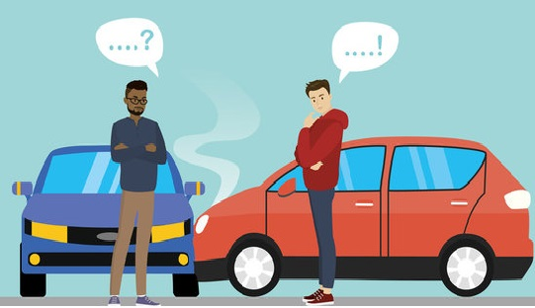
Problem Definition
Road accident is most unwanted thing to happen to a road user, though they happen quite often
The most unfortunate thing is that people don't learn from their mistakes on road
Most of the road users are quite well aware of the general rules and safety measures while using roads
But it is only the laxity on part of road users, which cause accidents and crashes
Main cause of accidents and crashes are due to human errors
The most common behavior of road drivers which lead to accidents are Over Speeding and Distraction to Driver

Slide 8
Objectives
Objectives
1 | To develop control system for speed control based on Deep Neural Network
2 | To provide safety and stress-free driving atmosphere to the passengers
3 | To save lives and reduce the amount of property damage that occurs during an accident
4 | To provide the intelligence in the braking and speed control system

Slide 9
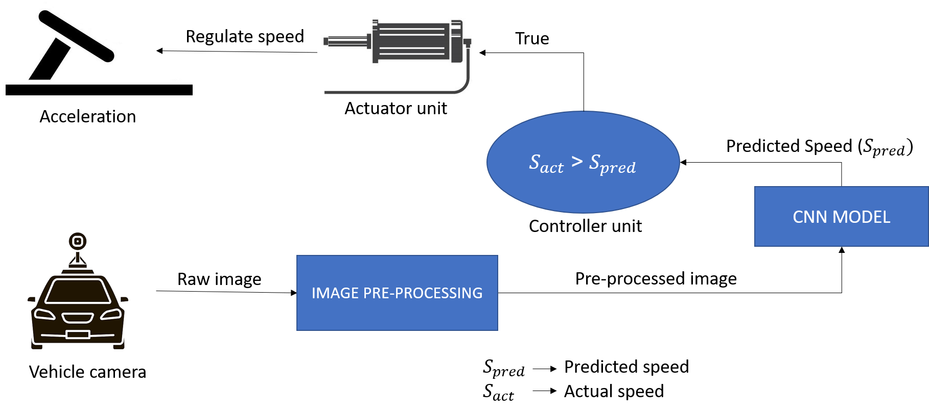
Methodology & Work Done
Automatic braking and speed control System (ABSC) basically controls the speed of the vehicle by continuously feeding the driving atmosphere to the pre-trained deep neural network as digital image captured by the camera sensor​
The Neural Network predicts the desired speed for that instant

Slide 10
If the predicted speed is less than actual speed of the vehicle, the vehicle’s embedded unit automatically alerts the driver to reduce the speed and waits for the user response ​
If it doesn’t get any input from the user , the controller will calculate the change in speed between previous and current instants and correspondingly the acceleration
The controller will send signal to the actuator to move the accelerate peddle to attain speed predicted by the NN
Steps involved in the process,
Collect the environment data using Camera sensor
Pre-processed the collected image
Feed pre-processed image to the AI model
Maintain / reduce / increase the speed as predicted by the model

Slide 11
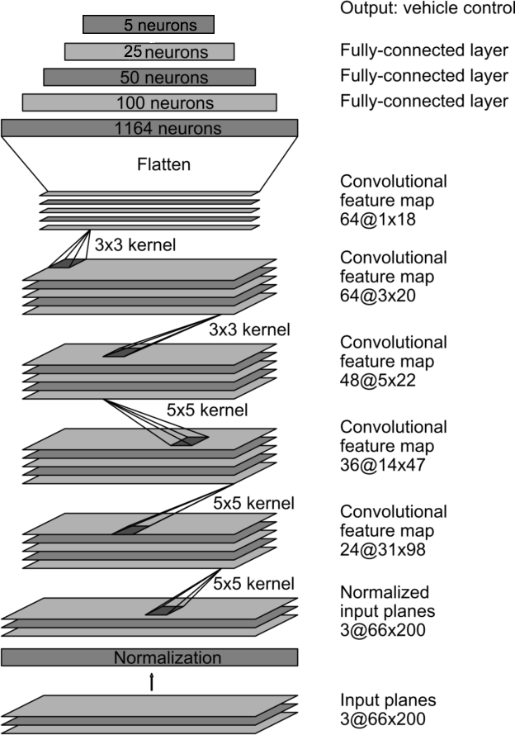
Model architecture
A CNN typically has two layers: a convolutional layer and a fully connected layer.
The network architecture consists of 9 layers, including a normalization layer, 5 convolutional layers, and 4 fully connected layers​
The network has about 27 million connections and 250 thousand parameters
The convolutional layers are designed to perform feature extraction, and are chosen empirically through a series of experiments that vary layer configurations
We then use strided convolutions in the first three convolutional layers with a 2×2 stride and a 5×5 kernel, and a non-strided convolution with a 3×3 kernel size in the final two convolutional layers
Each layer is introduced with non-linearity with ReLU activation function and the output layer consists of log SoftMax function for multi-class classification
The output will be any one of the range between 0-5, 5-15, 15-25, 25-35, more than 35
Fig. 1.1 Model Architecture

Slide 12



Key elements involved in Convolutional Deep Neural Network
1. Convolution
This layer performs a dot product between two matrices, where one matrix is the set of learnable parameters known as a kernel, and the other matrix is the restricted portion of the receptive field
The kernel is spatially smaller than an image but is more in-depth
The kernel slides across the height and width of the image-producing the image representation of that receptive region, a two-dimensional representation of the image known as an activation map
$$Fig. 2.1.1 3×3 Kernel$$
2. Loss function
The loss function in a neural network quantifies the difference between the expected outcome and the outcome produced by the machine learning model
The loss function is used to derive the gradients which are used to update the weights.
Fig. 2.1.2 Convolution

Slide 13
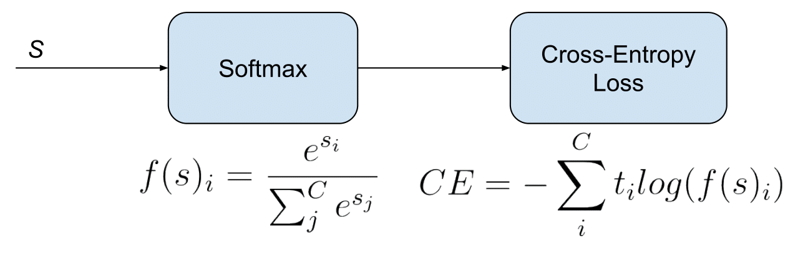
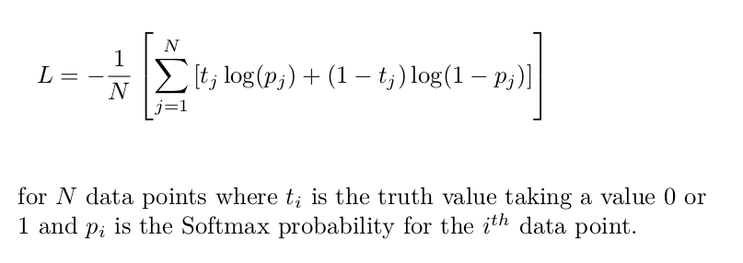
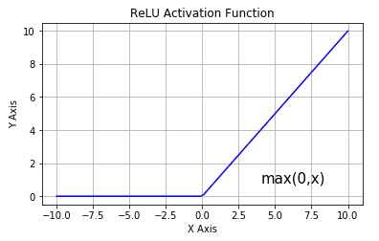
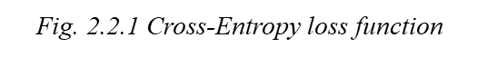
Also called logarithmic loss, log loss or logistic loss
Each predicted class probability is compared to the actual class desired output 0 or 1 and a loss is calculated that penalizes the probability based on how far it is from the actual expected value
Fig. 2.2.1 Cross-Entropy loss function
Activation functions
ReLU
The Rectified Linear Unit (ReLU) has become very popular in the last few years. It computes the function ƒ(κ)=max (0,κ). In other words, the activation is simply threshold at zero
Fig. 2.3.1 ReLU Activation Function

Slide 14
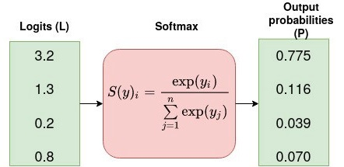
The SoftMax function is used as the activation function in the output layer of neural network models that predict a multinomial probability distribution
That is, SoftMax is used as for multi-class classification problems where class membership is required on more than two class labels
Softmax
Fig. 2.3.2 SoftMax Activation Function
The other activation functions include Sigmoid, tanH, ELU, etc.
4. Optimization Algorithm
An optimization algorithm is that which modifies the attributes of the neural network such as weights and biases
It helps in reducing the overall loss and improve the accuracy
The terms related to the optimization process include,
Epoch – The number of times the algorithm runs on the whole training dataset.
Sample – A single row of a dataset.
Batch – It denotes the number of samples to be taken to for updating the model parameters.
Learning rate – It is a parameter that provides the model a scale of how much model weights should be updated.

Slide 15
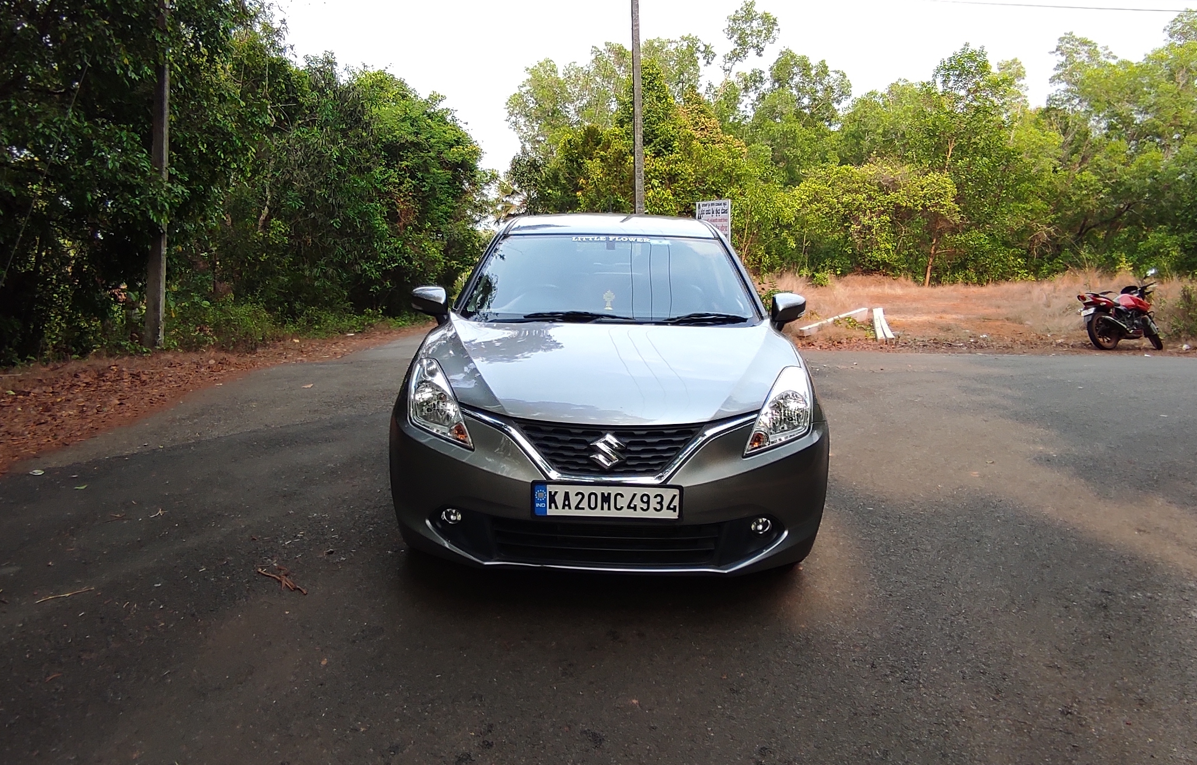
Adam optimization algorithm has recently seen broader adoption for deep learning applications in computer vision and natural language processing
Straightforward to implement, computationally efficient, little memory requirements, well suited for problems that are large in terms of data and/or parameters, hyper-parameters have intuitive interpretation and typically require little tuning
3. Procedure involved,
1. Data collection/generation
Fig. 2.4.1 Optimization algorithm characteristics
Training data has to be collected by driving on a wide variety of roads and in a diverse set of lighting and weather conditions but due to the time limitations we were only able to collect data by driving our vehicle about 5-6 km in a bitumen road
The data was acquired using Maruthi Suzuki Baleno as test vehicle
The camera was placed at the middle position but this system has no dependencies on any particular vehicle model
Data was collected in clear weather but it has to be collected in cloudy, foggy, snowy, and rainy weather, both day and night
Fig. 3.1 Picture of Vehicle used for data collection (Maruti Suzuki Baleno)

Slide 16
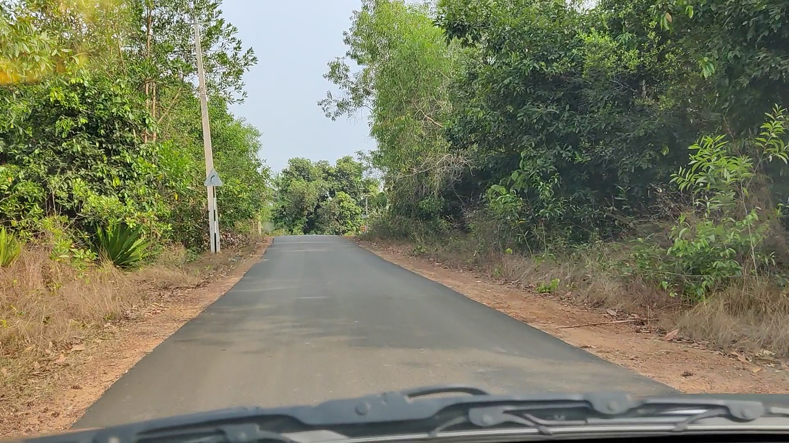
Driver was encouraged to maintain full attentiveness
To train the model, we have selected data where the driver was staying in a lane and discard the rest
We then sampled the video at 10 FPS because a higher sampling rate would include images that are highly similar, and thus not provide much additional useful information
To remove a bias towards driving straight the training data includes a higher proportion of frames that represent road curves
Fig. 3.2.1 Raw image from the vehicle camera
2. Image processing
The aim of the preprocessing is to enhance the image features to avoid the distortion
Image preprocessing is very necessary aspect as the image should not have any impurities
The factors like noise and other aspects need to be eliminated
It is necessary for the preprocessing to remove noise

Slide 17
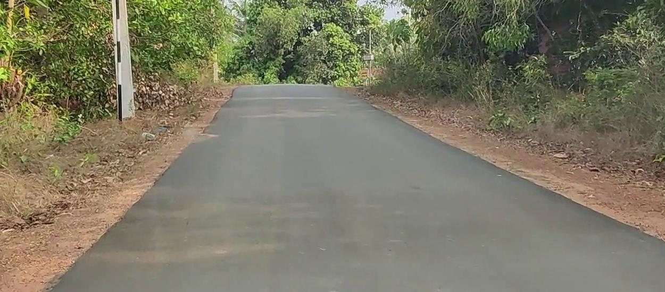
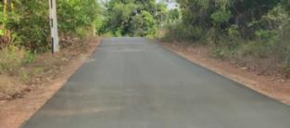
Windowing/Cropping
Image cropping or Windowing is a technique that is used to select the most relevant areas of an image, discarding the useless ones
Handmade selection, especially in case of large photo collections, is a time consuming task
So we have used Automatic image cropping technique to extract the part of the image that was most relevant, according to specific
Fig. 3.2.1 Image after performing windowing
Data size reduction
The Gaussian pyramid was used to scale down the image to smaller size.
It is a technique in image processing that breaks down an image into successively smaller groups of pixels to blur it
The "pyramid" is constructed by repeatedly calculating a weighted average of the neighboring pixels of a source image and scaling the image down
Fig. 3.2.3 Image after performing pyramid scale for lowering of resolution

Slide 18
Label Encoding (Converting text label to numeric label)
Index | Speed Range | Labels (Text) | Labels (Numeric)
1 | 0 <= x <= 5 | stop | 0
2 | 5 < x <= 15 | very low | 1
3 | 15 < x <= 25 | low | 2
4 | 25 < x <= 35 | medium | 3
5 | x > 35 | high | 4
In machine learning, we usually deal with datasets that contain multiple labels in one or more than one columns
To make the data understandable or in human-readable form, the training data is often labelled in words
Label Encoding refers to converting the labels into a numeric form so as to convert them into the machine-readable form
Machine learning algorithms can then decide in a better way how those labels must be operated
It is an important pre-processing step for the structured dataset in supervised learning
Table. 1.1 Mapping speed range to label
Normalization
Normalization is a data preparation technique that is frequently used in machine learning
The process of transforming the columns in a dataset to the same scale is referred to as normalization

Slide 19
It is required only when features of machine learning models have different ranges
The most widely used types of normalization in machine learning are,
Min-Max Scaling
Standardization Scaling
Fig. 3.4 Normalization
Splitting the data
The data collected has to be split into three groups namely,
Training Dataset
Testing Dataset
Validation Dataset
The train-test split procedure is used to estimate the performance of machine learning algorithms
It is a fast and easy procedure to perform which is used to make predictions on data not used to train the model
It can be used for classification or regression problems

Slide 20
Training Dataset
The sample of data used to fit the model
The actual dataset that we use to train the model (weights and biases in the case of a Neural Network)
The model sees and learns from this data
Validation Dataset
The sample of data used to provide an unbiased evaluation of a model fit on the training dataset while tuning model hyperparameters
The evaluation becomes more biased as skill on the validation dataset is incorporated into the model configuration
The validation set is used to evaluate a given model, but this is for frequent evaluation
Test Dataset
The sample of data used to provide an unbiased evaluation of a final model fit on the training dataset
The Test dataset provides the gold standard used to evaluate the model
It is only used once a model is completely trained(using the train and validation sets)
The test set is generally what is used to evaluate competing models
It contains carefully sampled data that spans the various classes that the model would face, when used in the real world

Slide 21
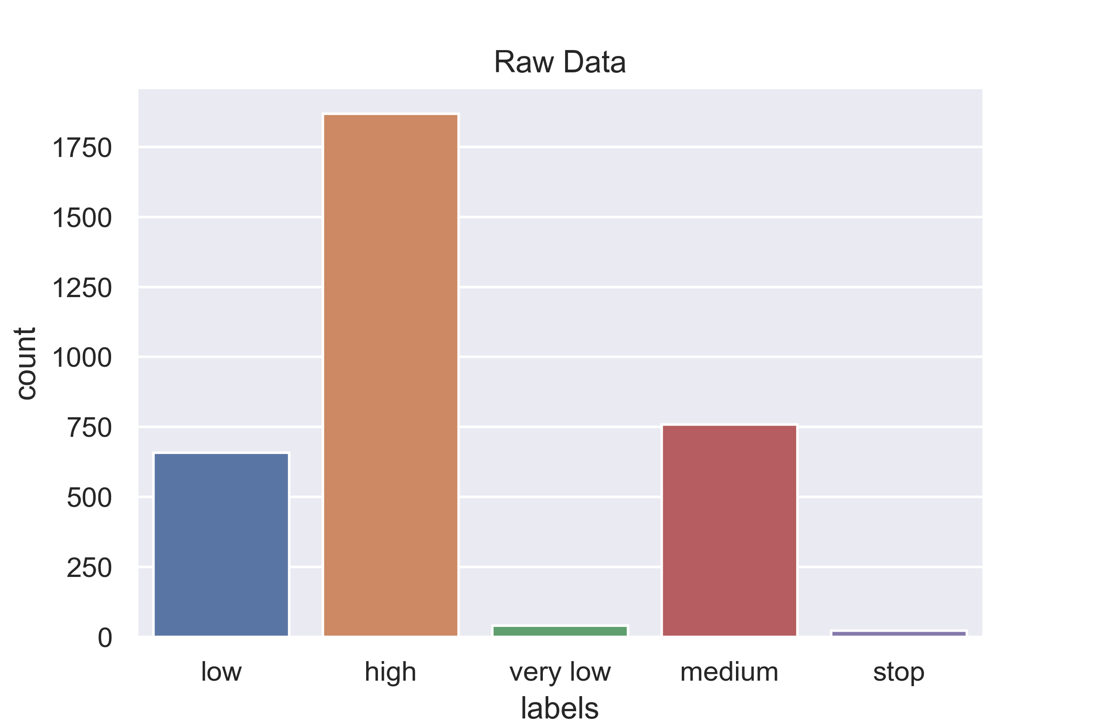
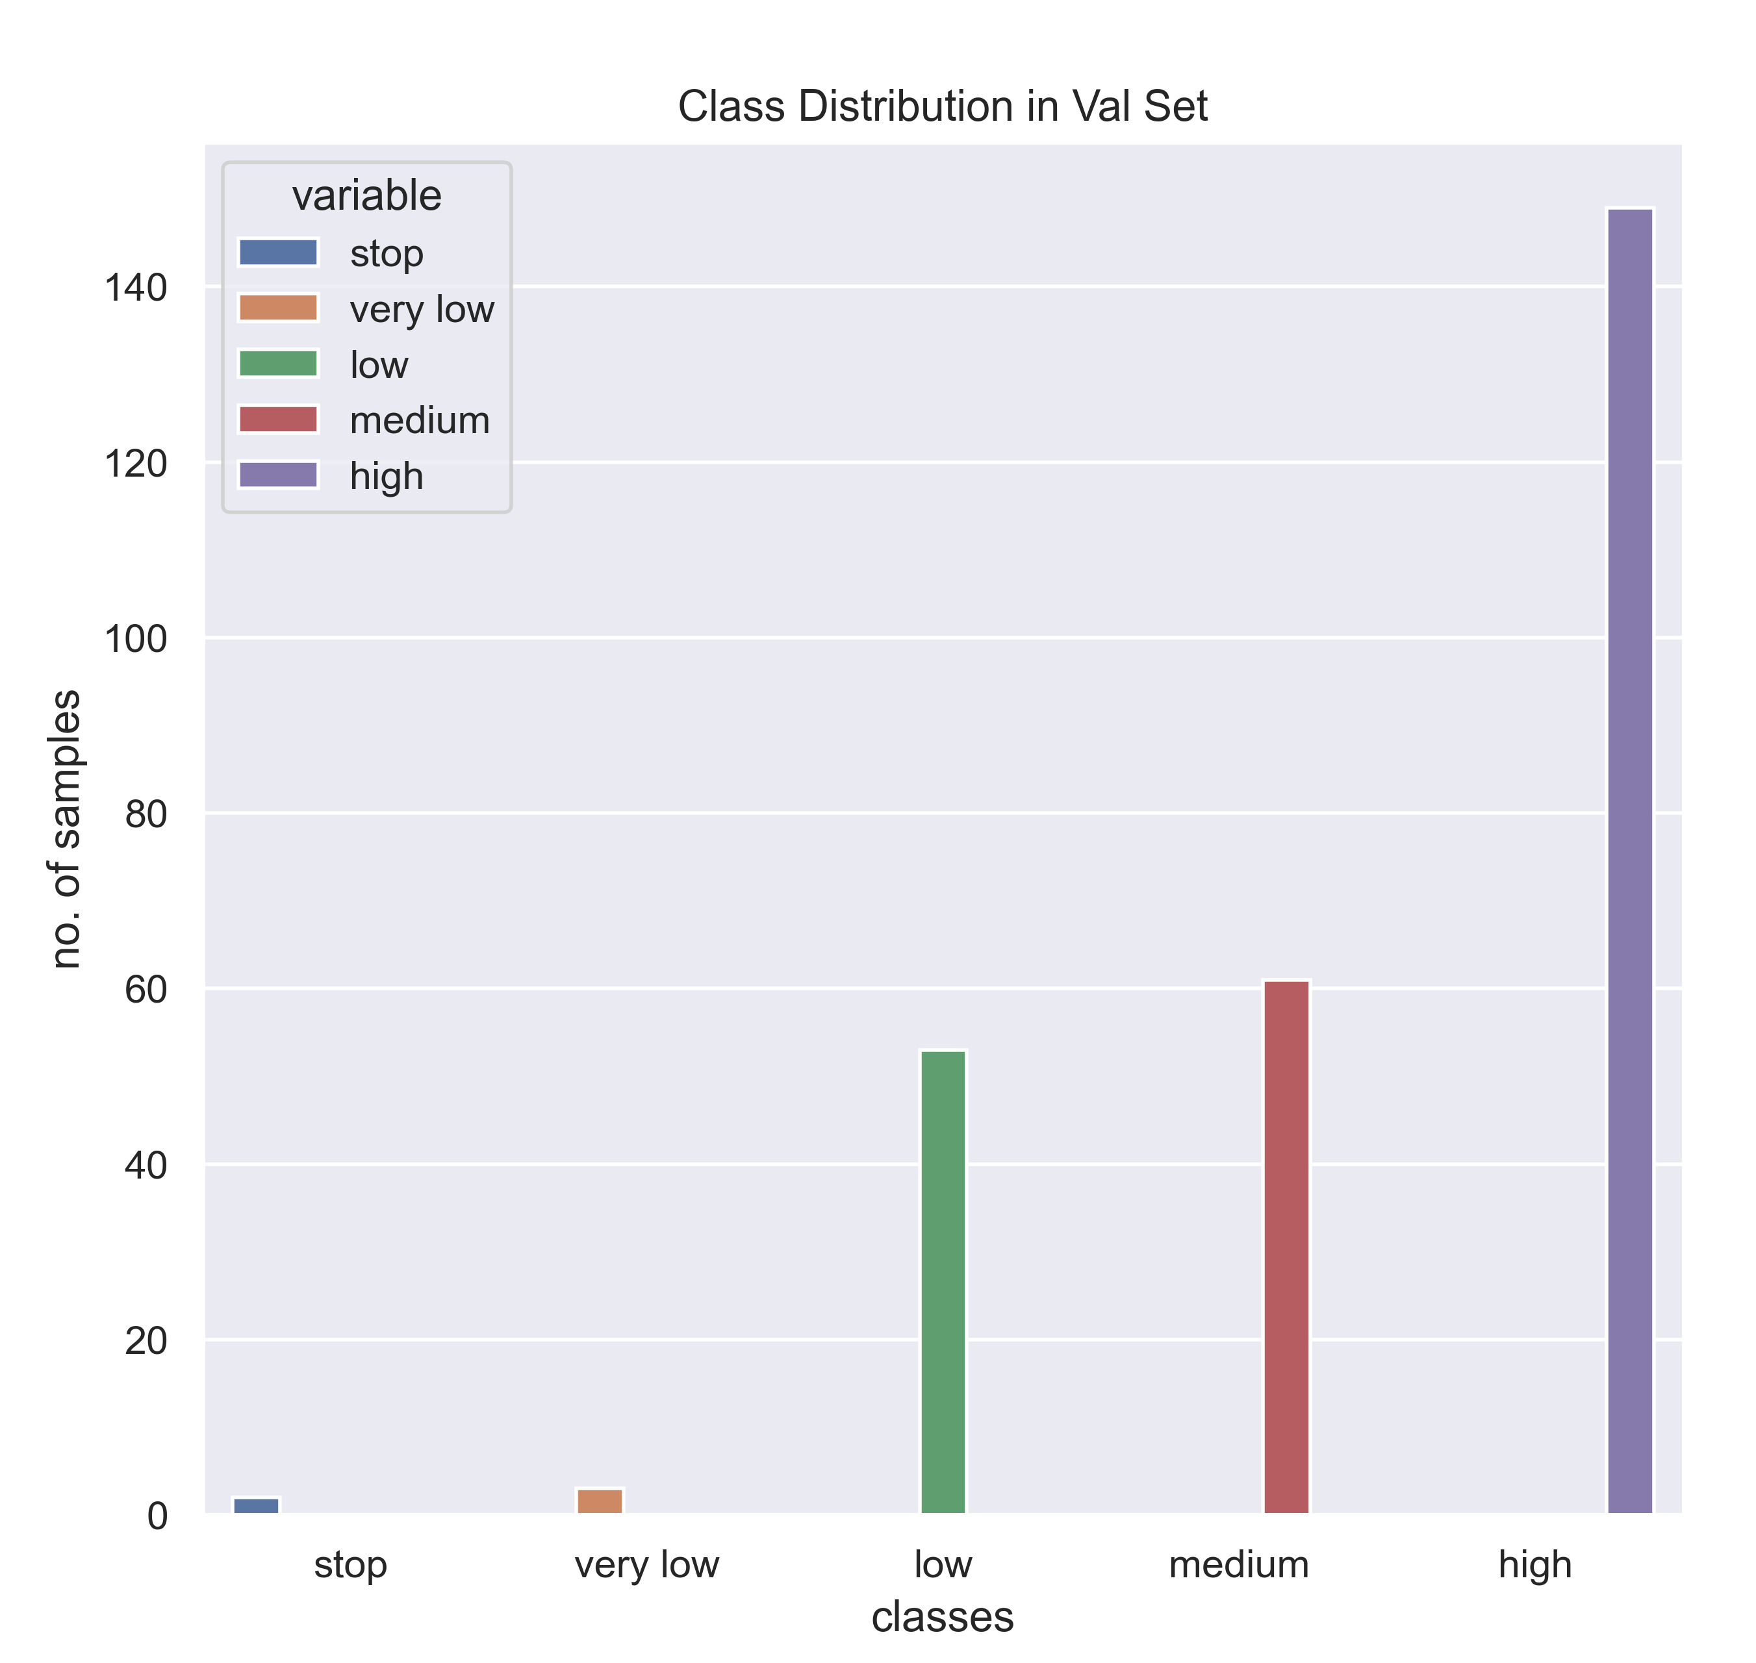
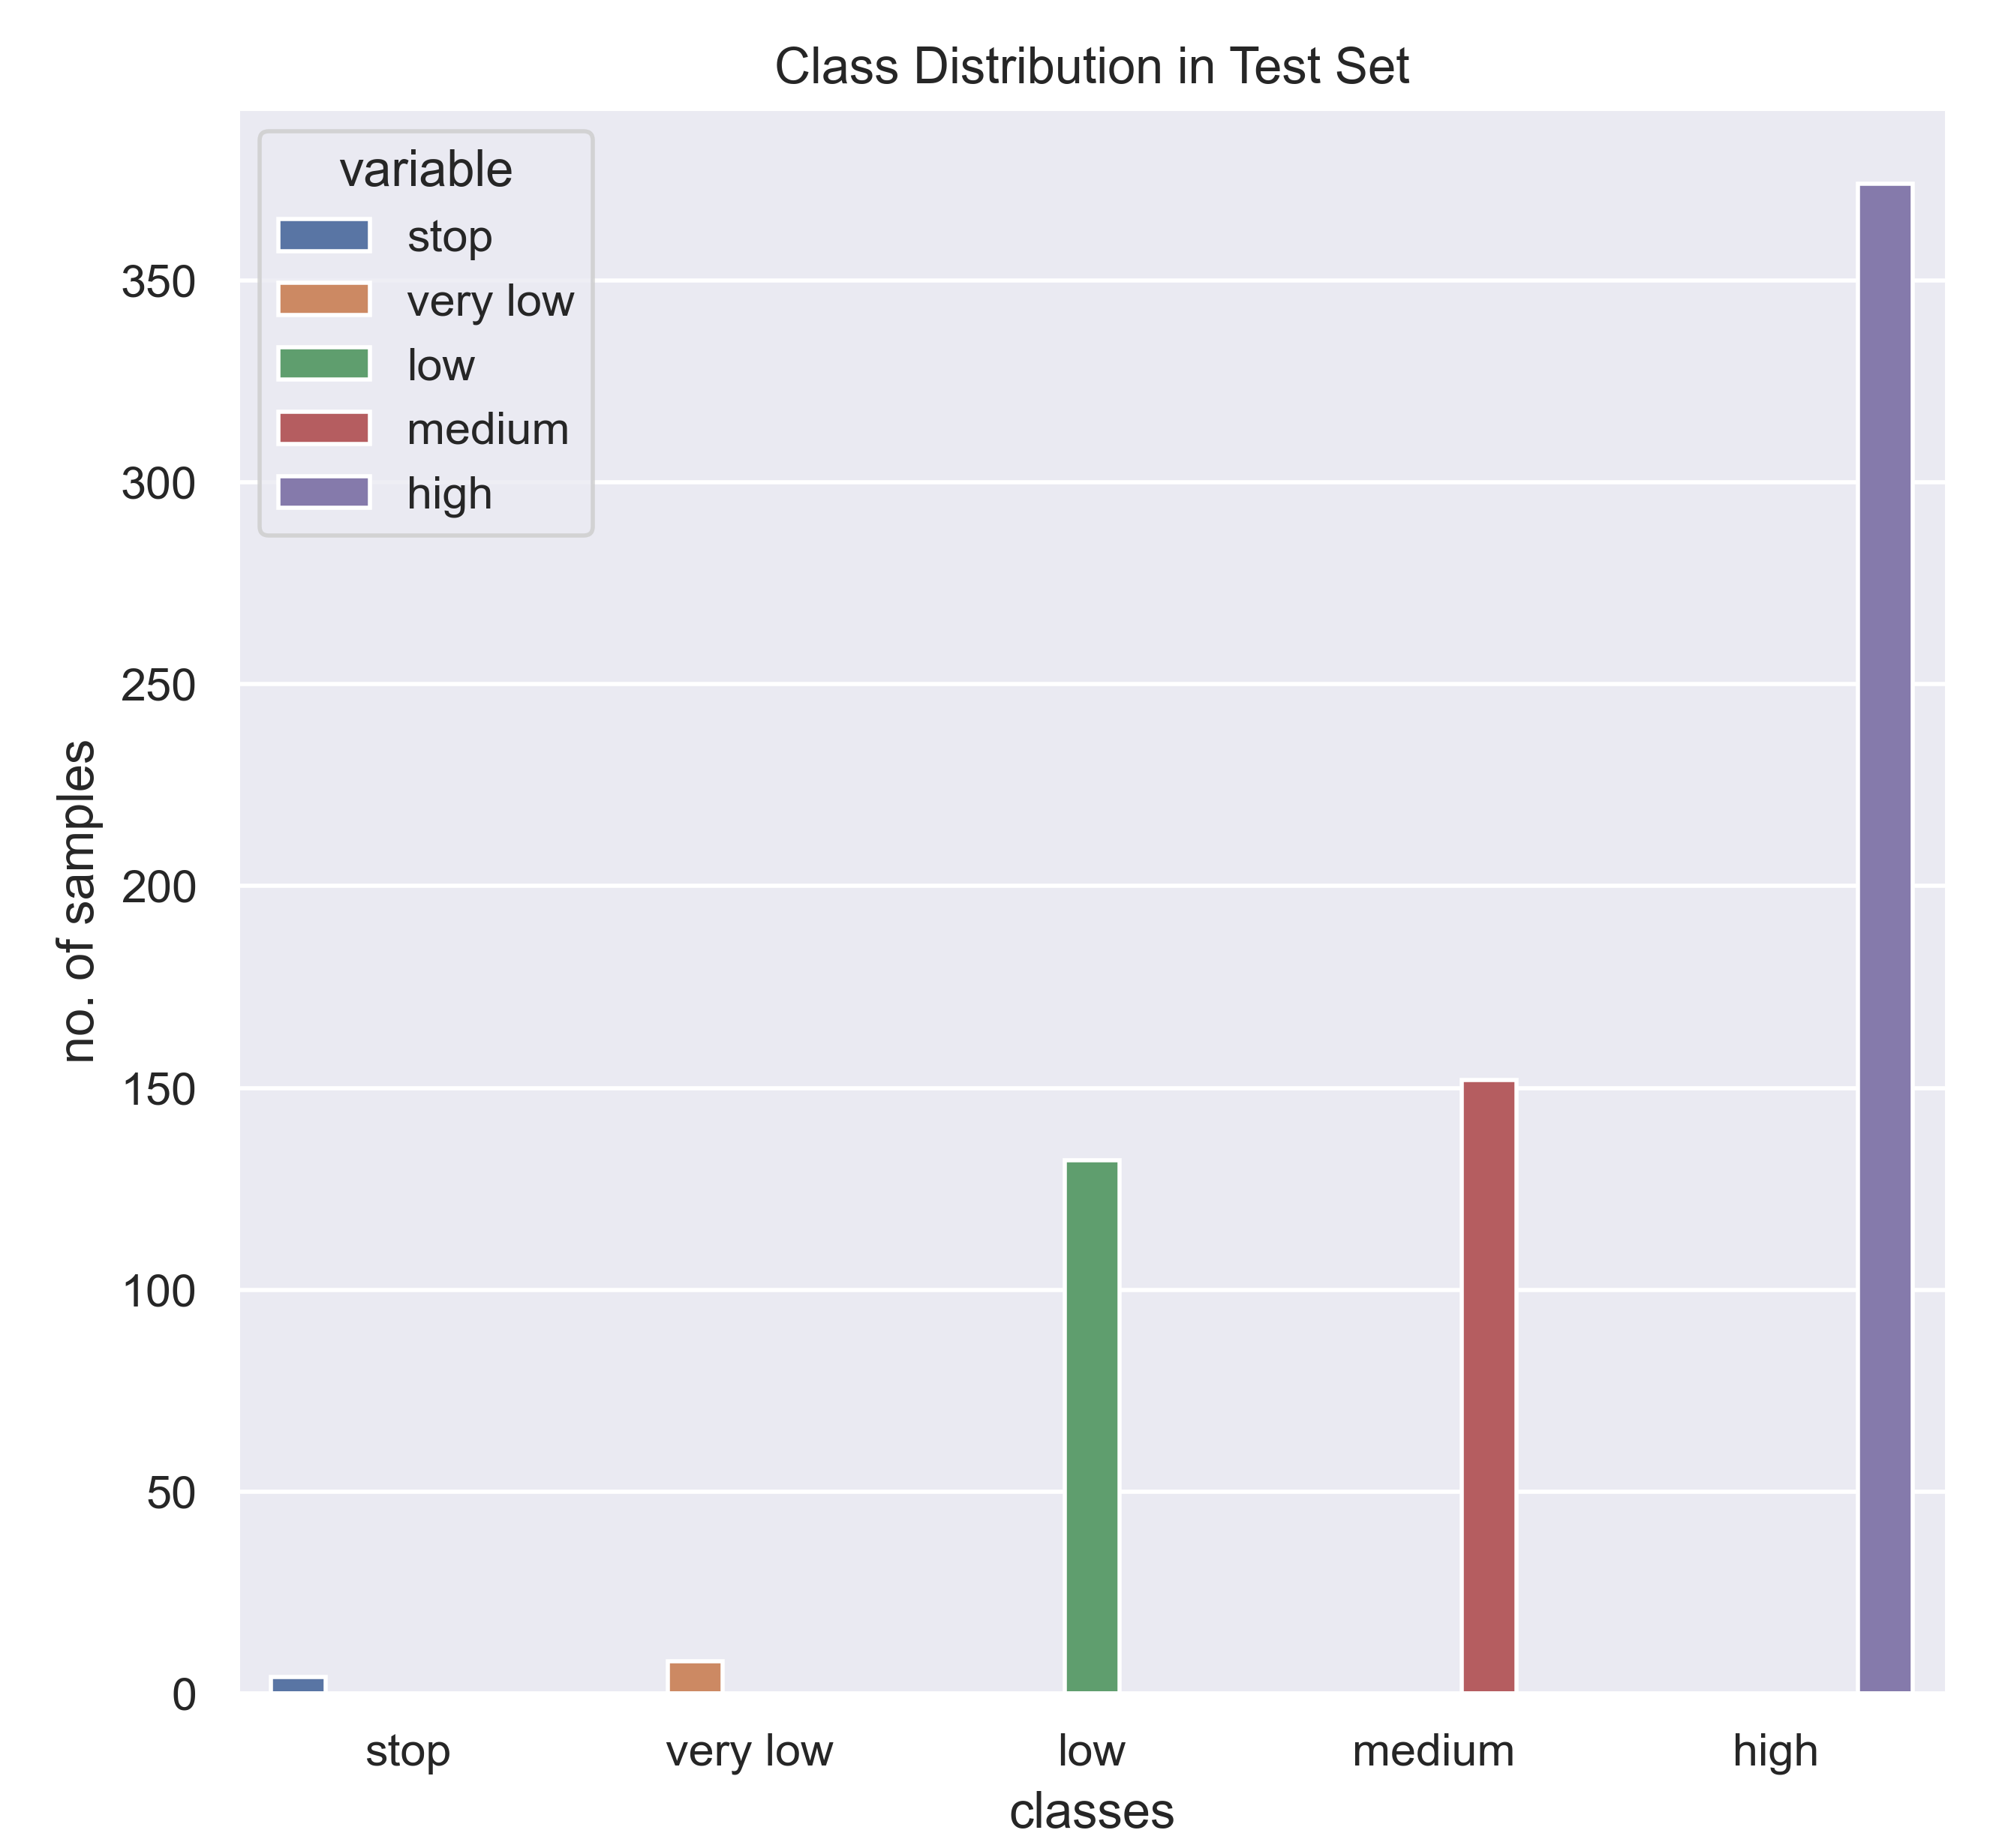
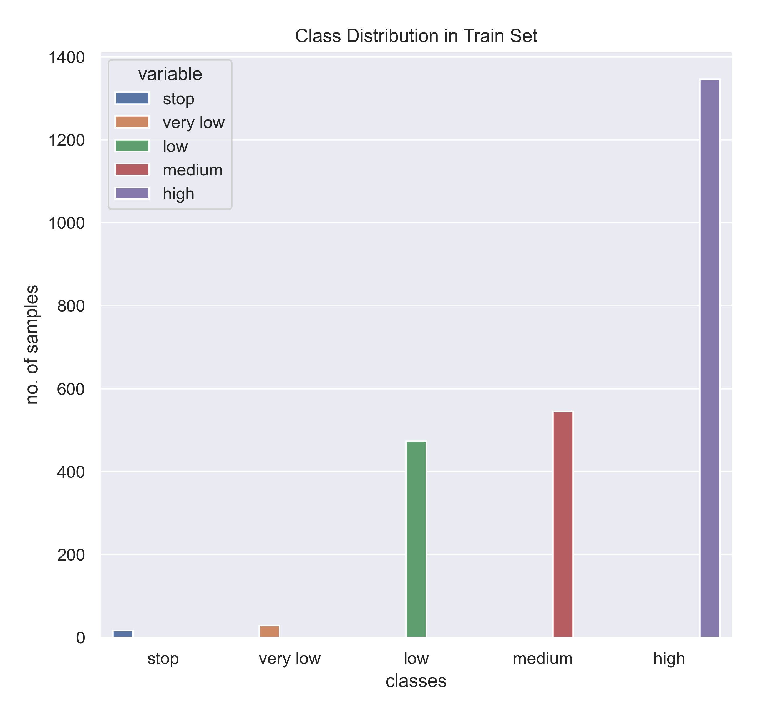
Fig. 3.3.1 Class distribution in whole data
Fig. 3.3.2 Class distribution in train data
Fig. 3.3.3 Class distribution in validation data
Fig. 3.3.4 Class distribution in test data

Slide 22
Training the model
Model training in machine language is the process of feeding an ML algorithm with data to help identify and learn good values for all attributes involved
Since it is a supervised learning, we have 5 classes of data as output data labels which has to be predicted by the CNN model
CNN Model has been trained for train dataset of 2875 images and the validation dataset has 268 images
The training images were batched into 151 batches with 16 images in each batches
The validation of the model was carried out for each epoch
The model hyperparameters include,
Number of epochs = 300
Learning rate = 0.0007
The model parameters are those which are internal to the model and whose value can be estimated from data
The model hyperparameter are configuration variables that are external to the model and whose value cannot be estimated from data
They are often specified by the practitioner and often tuned for a given predictive modeling problem

Slide 23
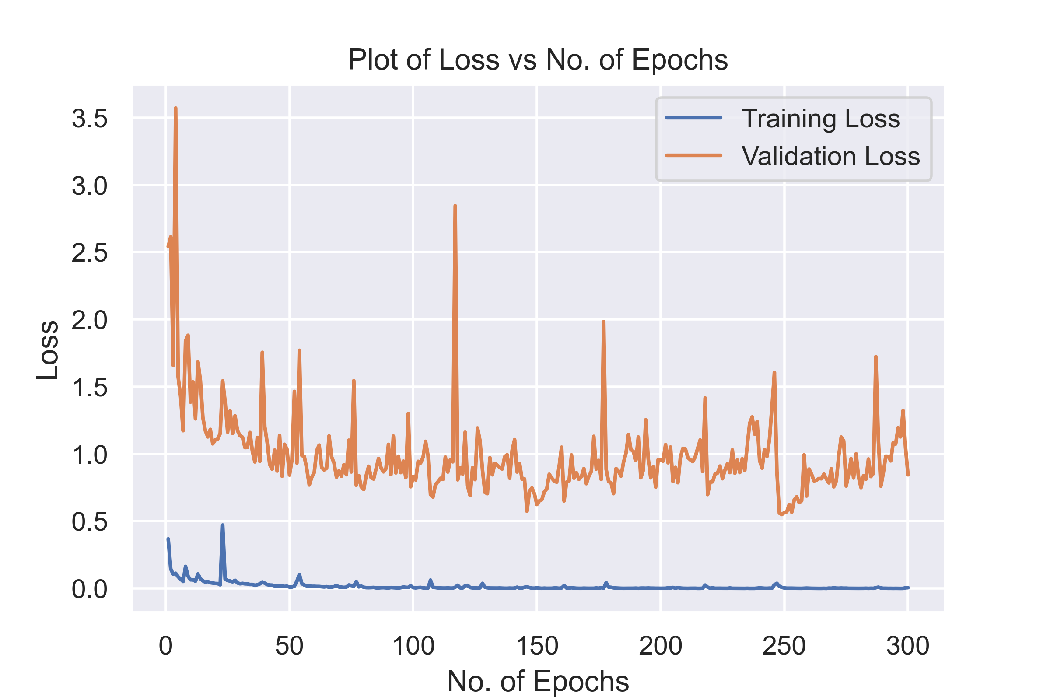
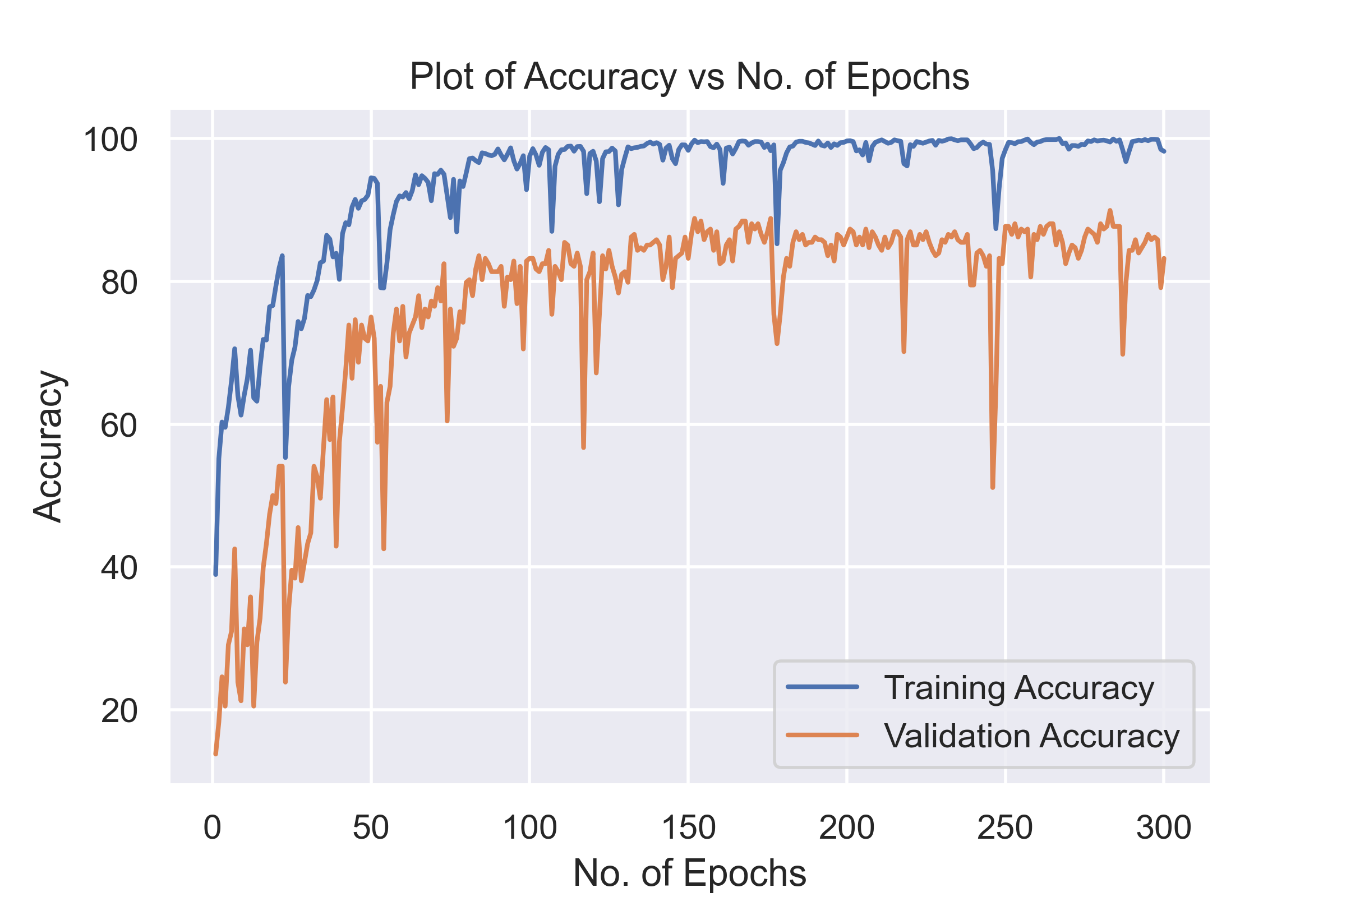
The plot of the variation of the training loss with the epoch is shown below.
The variation of train accuracy and validation accuracy was also plotted against number of epochs
At the beginning the training loss and validation loss were high
As the model was introduced with more and more training samples and the number of epochs increased the training loss got reduced along with the validation
The minimum train loss was about 0.03 and the train accuracy was 99%
The validation loss was 0.55 and the validation accuracy was 89%
Fig. 3.4.0 Plot of loss vs number of epochs
Fig. 3.5.0 Plot of accuracy vs number of epochs

Slide 24
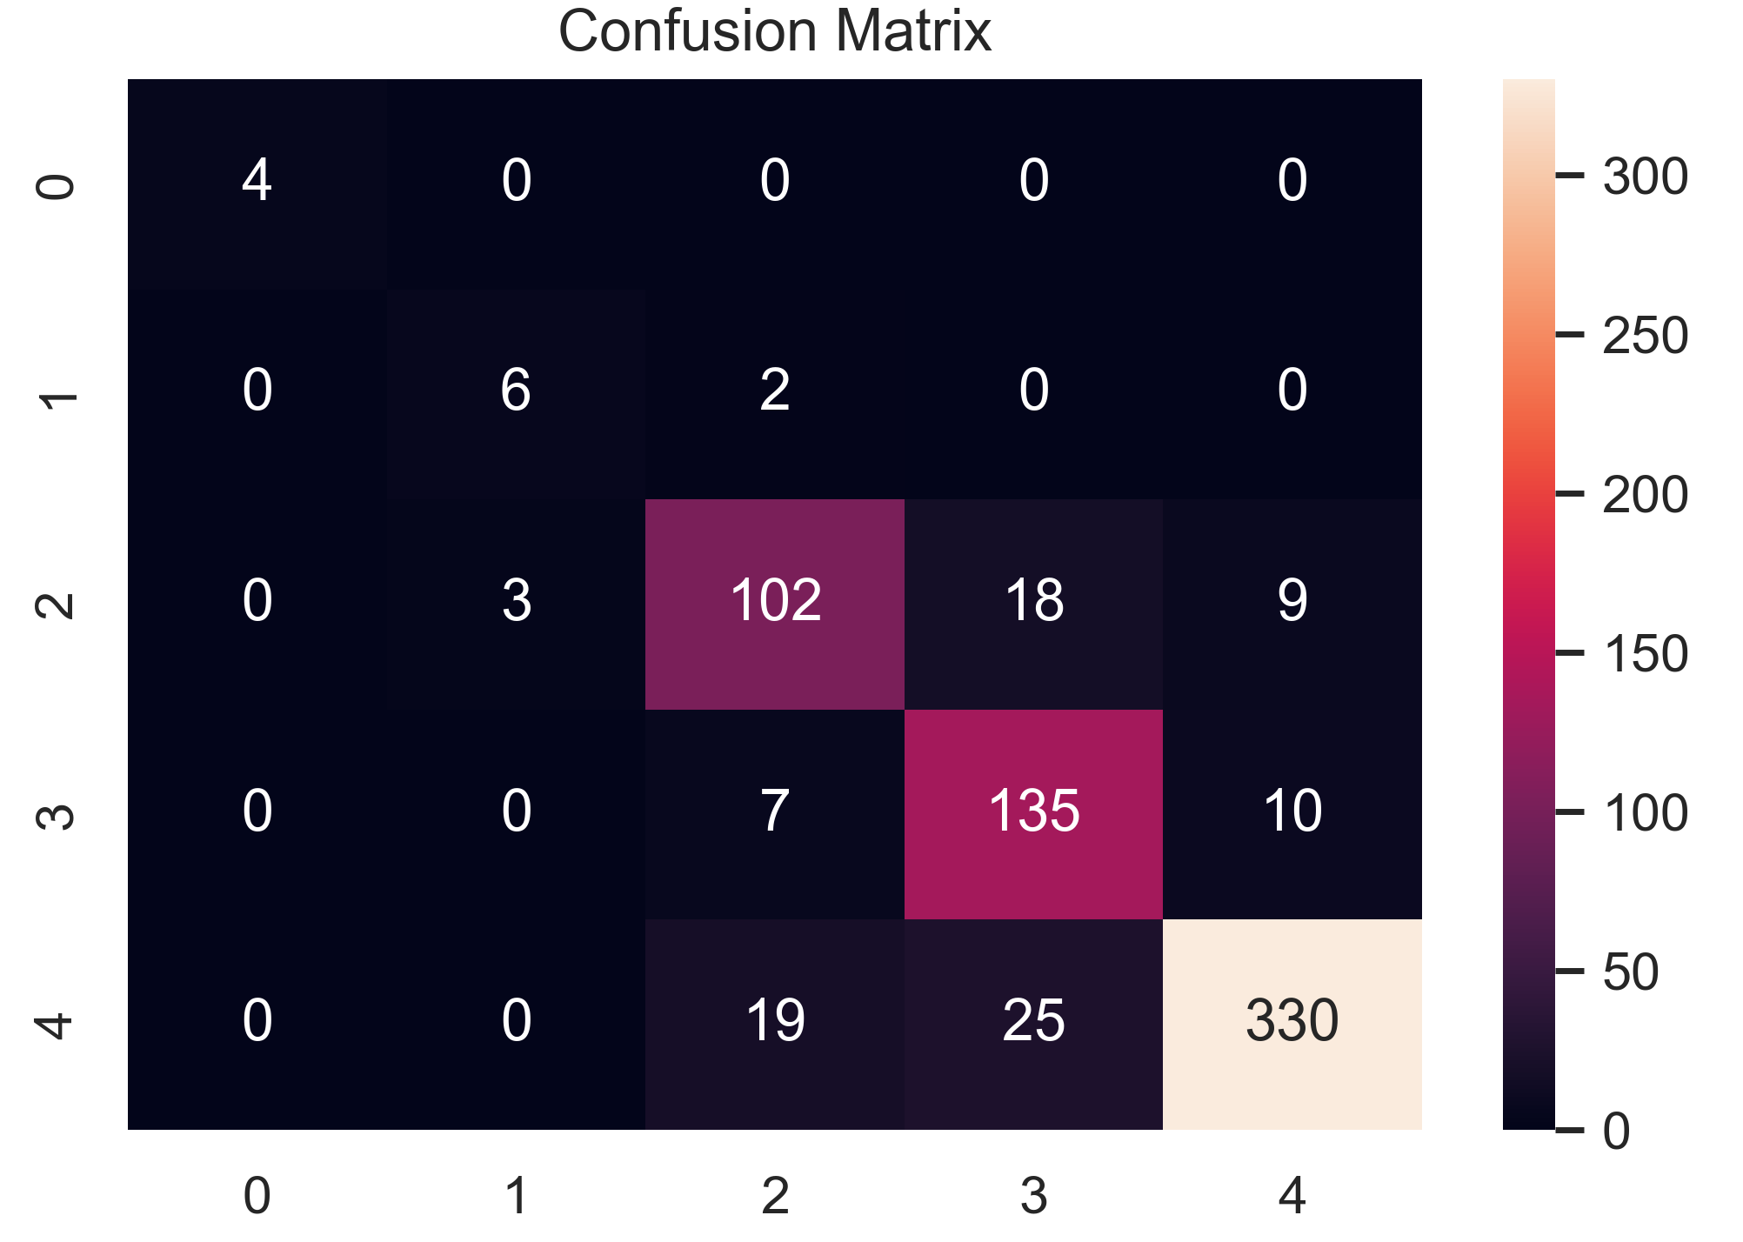
Testing and Evaluation
Model testing is referred to as the process where the performance of a fully trained model is evaluated on a testing set
The testing set consisting of a set of testing samples should be separated from the both training and validation sets
The testing set consists of 670 images with all classes of data which follows the same probability distribution of data as that of training data
Model testing involves explicit checks for behaviors that we expect our model to follow
The testing was done on the test images and the test accuracy was about 87%
The confusion matrix for the test results is shown below and the model is evaluated based on that results
Out of 349 high speed class data , the model could correctly identify 330 images as high speed region and 10 images were classified as medium and 9 images were classified as low speed range
Fig. 3.6.0 Confusion matrix of model prediction for test images

Slide 25
Results & Discussions
CNN Model has been trained for train dataset of 2875 images and the validation dataset has 268 images
The train loss was about 0.03 and the train accuracy was 98% after 150 epochs
After epoch 100, the model was come to saturation which implies that the 100 epochs are enough for the model to learn optimum parameters
The testing was done for 670 images and the test accuracy was about 87%
The confusion matrix for the test results was visualized and we could see that the model got confused near higher speed regions
This was because the speed data that we collected from the vehicle was not optimal because of some disturbances during data acquisition
We have trained the model by tuning various model hyper-parameters like batch size, learning rate, number of epochs etc.
We have gone up to epochs of 300 and realized though the training loss was too low but the validation loss was fluctuating and it was started increasing and the model was over fitting the data
The learning rate was decreased from 0.007 to 0.001 but we were only able to increase the test accuracy by 1%
At the end ,we concluded that the training should require more training data for getting good results

Slide 26
Conclusion
The braking system based on the deep learning is intelligent way of brake control which exhibits desirable and consistent brake control behavior for various scenarios where behavior of the pedestrian is uncertain
It can reduce the velocity of the vehicle automatically when a threatening obstacle is detected
The autonomous braking offers safe and comfortable brake control without exhibiting too early or too late braking
The proposed system is more intelligent and prominent over conventional rule-based autonomous braking systems and servers as a principled and goal-oriented system
The main challenge here is that the model has to be trained for lots of kms. with different driving and weather conditions to get best results

Slide 27
Thank You.

